Slide 1
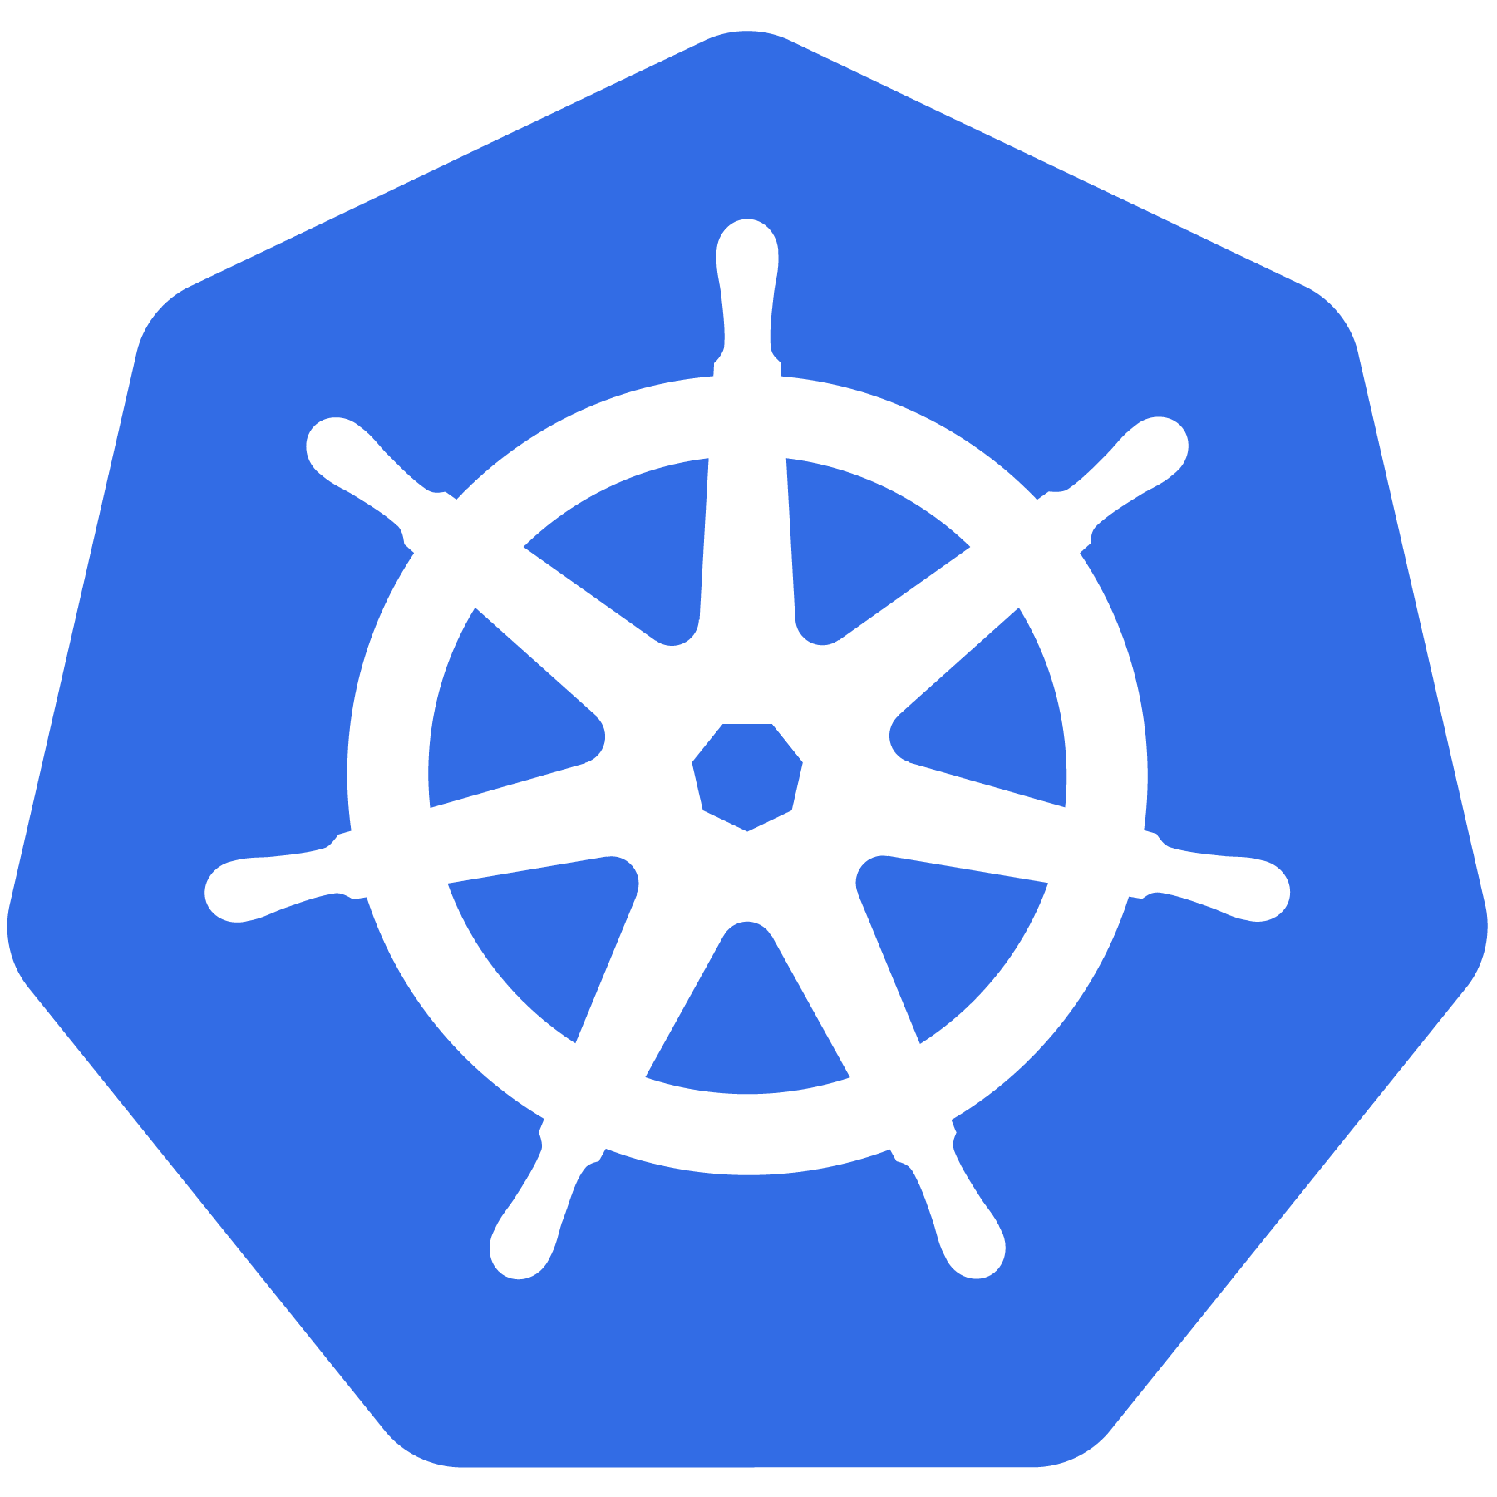
Deploying Production Ready Kubernetes Cluster

Slide 2
What is Kubernetes?
A Production-Grade Container Orchestration System Google-grown, based on Borg and Omega, systems that run inside of Google right now and are proven to work at Google for over 10 years.
Google spawns billions of containers per week with these systems.
Notes:
There’s a phrase called Google-scale. This was developed out of a need to scale large container applications across Google-scale infrastructure
borg is the man behind the curtain managing everything in google
Kubernetes is loosely coupled, meaning that all the components have little knowledge of each other and function independently.
This makes them easy to replace and integrate with a wide variety of systems

Slide 3
Container Orchestration System

Slide 4
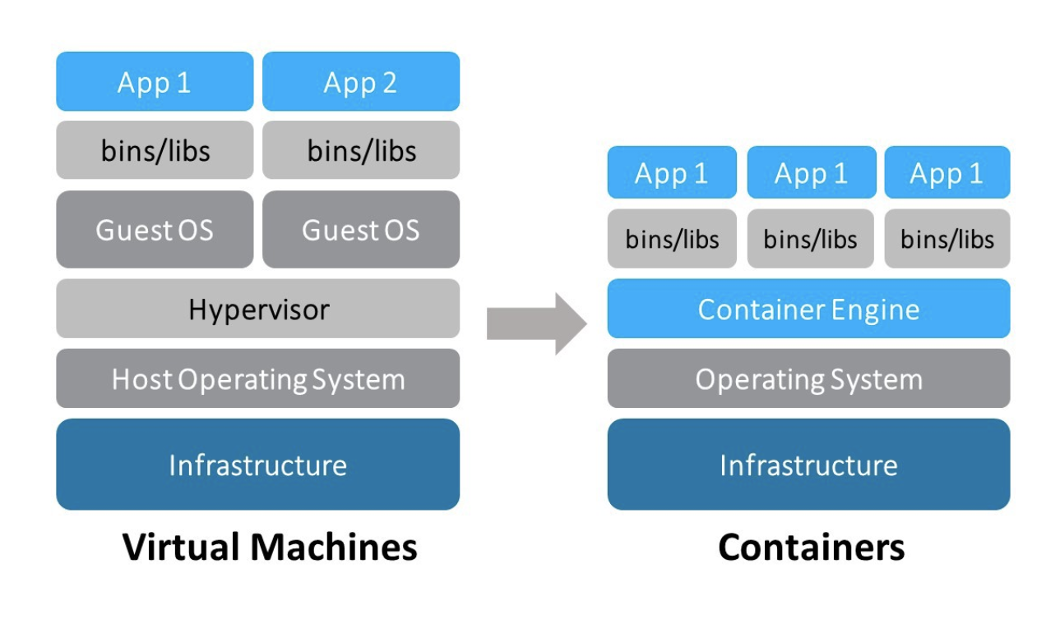
Containers
Containers allow a developer to package up an application with all of the parts it needs, such as libraries and other dependencies, and ship it all out as one package.
Containers are a form of operating system virtualization.
Read more: https://docs.google.com/presentation/d/1oAIfYr1otDg-RHNRYqUnt9bDouGDOGktolDyQRf50UM/edit?usp=sharing

Slide 5
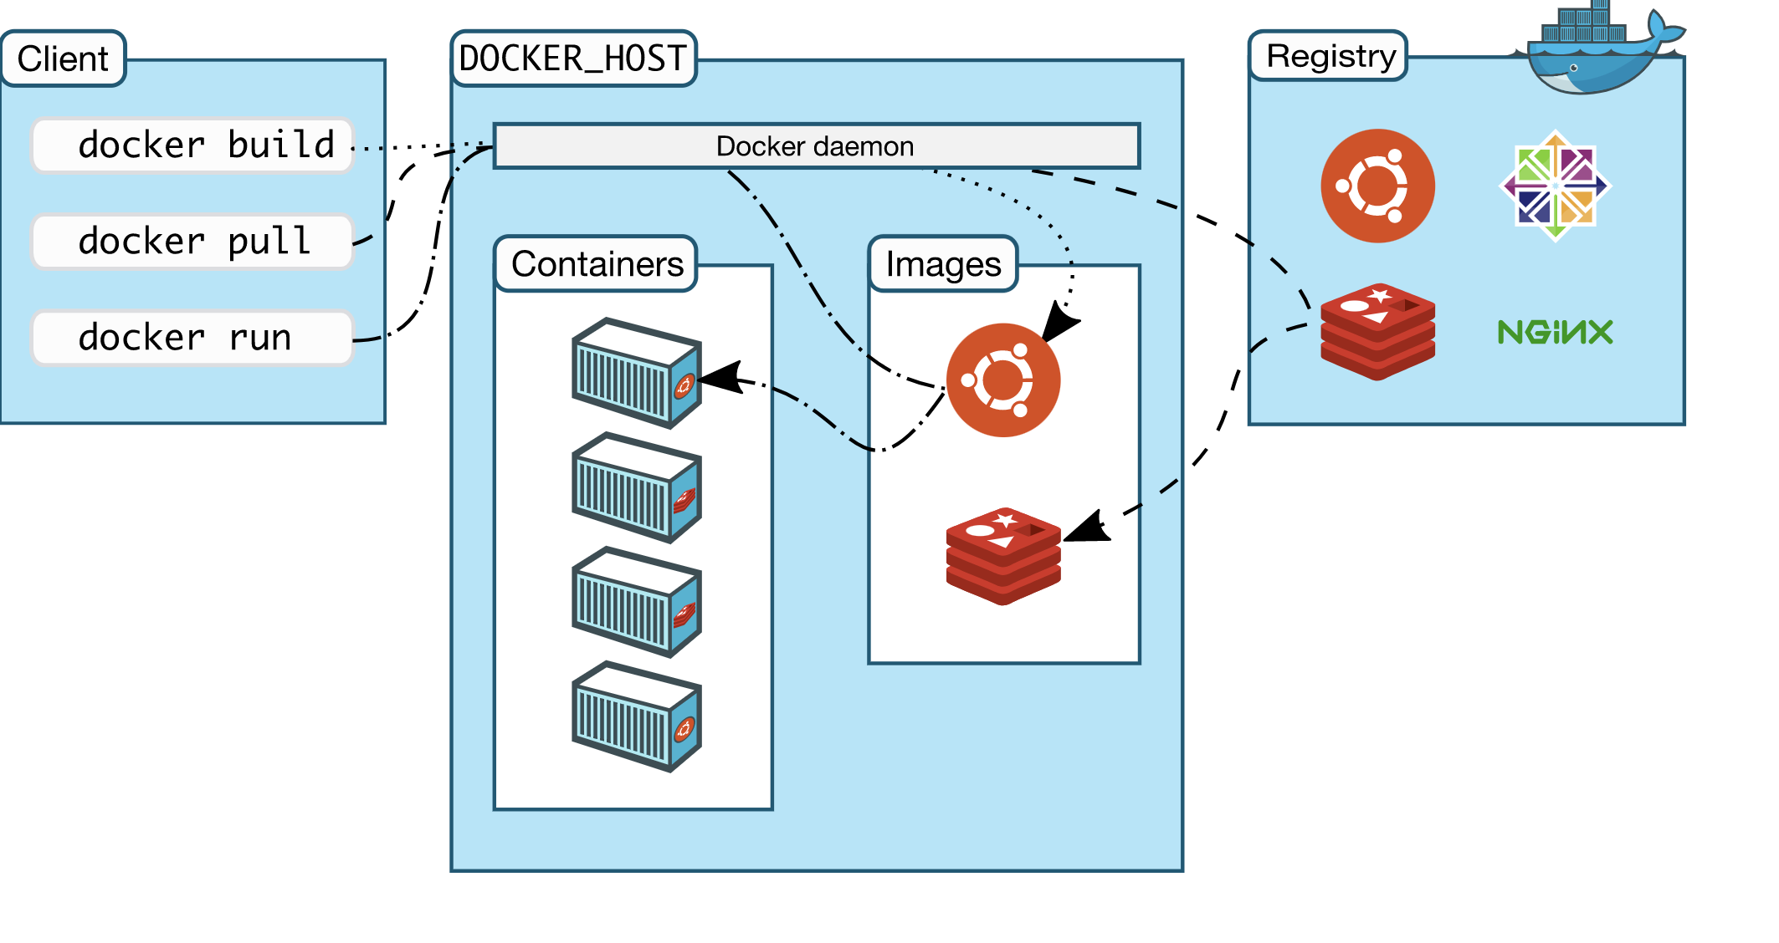
Containers
Image
A Docker image is a file, comprised of multiple layers, used to execute code in a Docker container.
Container
Containers allow a developer to package up an application with all of the parts it needs, such as libraries and other dependencies, and ship it all out as one package

Slide 6
Why Kubernetes?

Slide 7
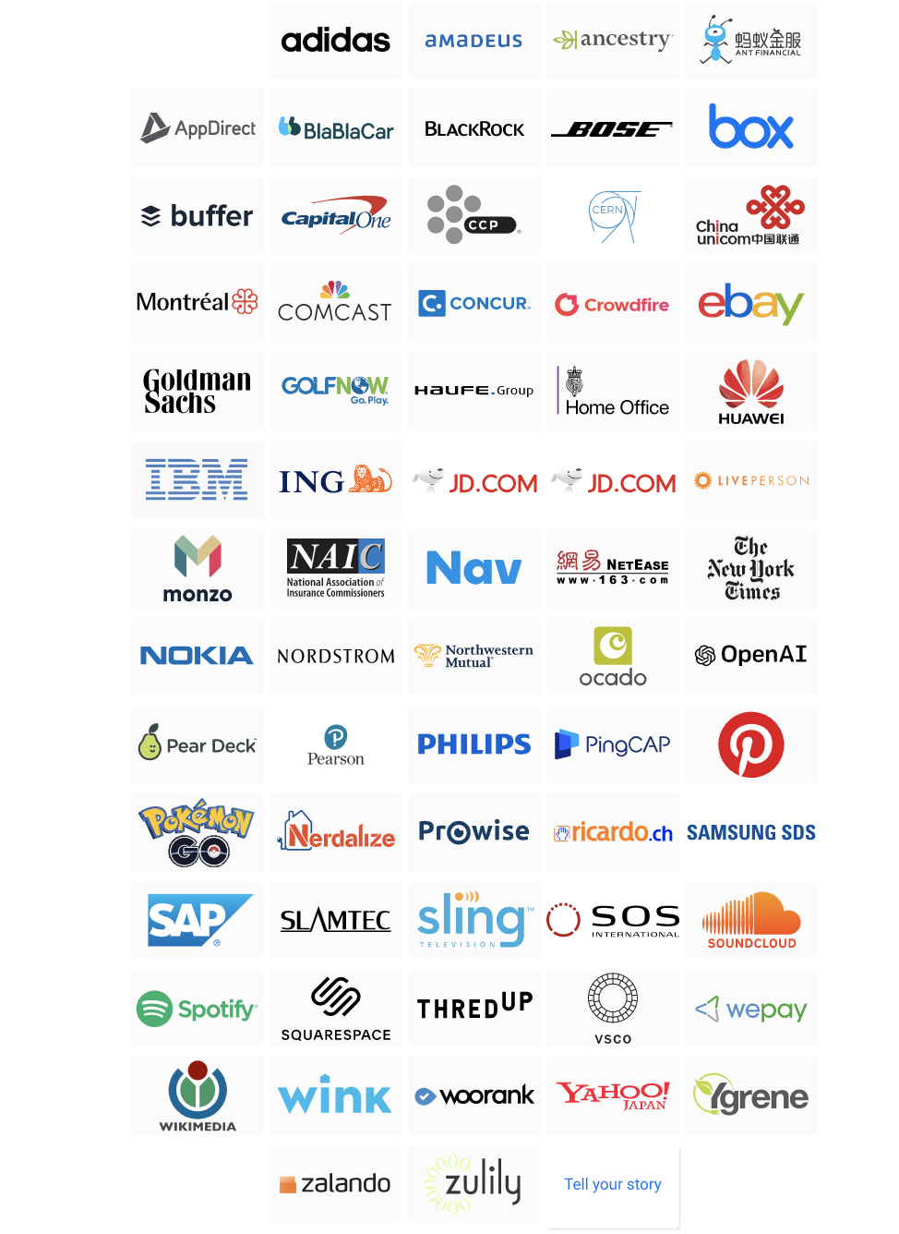
Source: https://kubernetes.io/case-studies/

Slide 8
Key Considerations
Automation
Self-Monitoring
Resource Sharing
Cost Reduction
Platform Agnostic
Scale in real time
High Availability...

Slide 9
Decouples Infrastructure and Scaling
All services within Kubernetes are natively Load Balanced.
Can scale up and down dynamically.
Used both to enable self-healing and seamless upgrading or rollback of applications.
Notes:
A lot of key components are batteries-included

Slide 10
Self Healing
Kubernetes will ALWAYS try and steer the cluster to its desired state.
Me: “I want 3 healthy instances of redis to always be running.”
Kubernetes: “Okay, I’ll ensure there are always 3 instances up and running.”
Kubernetes: “Oh look, one has died. I’m going to attempt to spin up a new one.”
Notes:
The instance will have a new IP and likely be on a different host, but Kubernetes gives the primitives for us to ‘not care’ about that.

Slide 11
Architecture

Slide 12
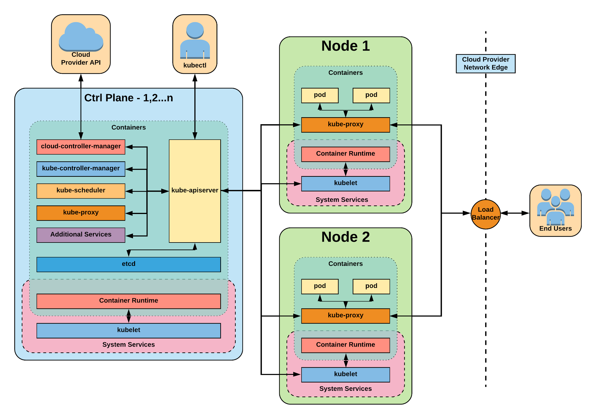
Notes:
The complete picture

Slide 13
Control Plane Components
Architecture Overview

Slide 14

Control Plane Components
kube-apiserver
etcd
kube-controller-manager
kube-scheduler
cloud-controller-manager
Notes:
Kube-apiserver
Gate keeper for everything in kubernetes
EVERYTHING interacts with kubernetes through the apiserver
Etcd
Distributed storage back end for kubernetes
The apiserver is the only thing that talks to it
Kube-controller-manager
The home of the core controllers
kube-scheduler
handes placement

Slide 15
kube-apiserver
Provides a forward facing REST interface into the kubernetes control plane and datastore.
All clients and other applications interact with kubernetes strictly through the API Server.
Acts as the gatekeeper to the cluster by handling authentication and authorization, request validation, mutation, and admission control in addition to being the front-end to the backing datastore.
Notes:
provides forward facing REST interface into k8s itself
everything, ALL components interact with each other through the api-server
handles authn, authz, request validation, mutation and admission control and serves as a generic front end to the backing datastore

Slide 16

etcd
etcd acts as the cluster datastore.
Purpose in relation to Kubernetes is to provide a strong, consistent and highly available key-value store for persisting cluster state.
Stores objects and config information.
Notes:
is the backing datastore
extremely durable and highly available key-value store
was developed originally by coreos now redhat
however it is in the process of being donated to the CNCF

Slide 17
kube-controller-manager
Monitors the cluster state via the apiserver and steers the cluster towards the desired state.
Node Controller: Responsible for noticing and responding when nodes go down.
Replication Controller: Responsible for maintaining the correct number of pods for every replication controller object in the system.
Endpoints Controller: Populates the Endpoints object (that is, joins Services & Pods).
Service Account & Token Controllers: Create default accounts and API access tokens for new namespaces.
Notes:
Its the director behind the scenes
The thing that says “hey I need a few more pods spun up”
Does NOT handle scheduling, just decides what the desired state of the cluster should look like
e.g. receives request for a deployment, produces replicaset, then produces pods

Slide 18
cloud-controller-manager
Node Controller: For checking the cloud provider to determine if a node has been deleted in the cloud after it stops responding
Route Controller: For setting up routes in the underlying cloud infrastructure
Service Controller: For creating, updating and deleting cloud provider load balancers
Volume Controller: For creating, attaching, and mounting volumes, and interacting with the cloud provider to orchestrate volumes
Notes:
Its the director behind the scenes
The thing that says “hey I need a few more pods spun up”
Does NOT handle scheduling, just decides what the desired state of the cluster should look like
e.g. receives request for a deployment, produces replicaset, then produces pods

Slide 19
kube-scheduler
Component on the master that watches newly created pods that have no node assigned, and selects a node for them to run on.
Factors taken into account for scheduling decisions include individual and collective resource requirements, hardware/software/policy constraints, affinity and anti-affinity specifications, data locality, inter-workload interference and deadlines.
Notes:
scheduler decides which nodes should run which pods
updates pod with a node assignment, nodes poll checking which pods have their matching assignment
takes into account variety of reqs, affinity, anti-affinity, hw resources etc
possible to actually run more than one scheduler
example: kube-batch is a gang scheduler based off LSF/Symphony from IBM

Slide 20
A Couple
Key Concepts...
Notes:
There are a few small things we should mention
It’s kind of a chicken and egg problem. But we need to talk about these before the stuff that supports and extends it

Slide 21
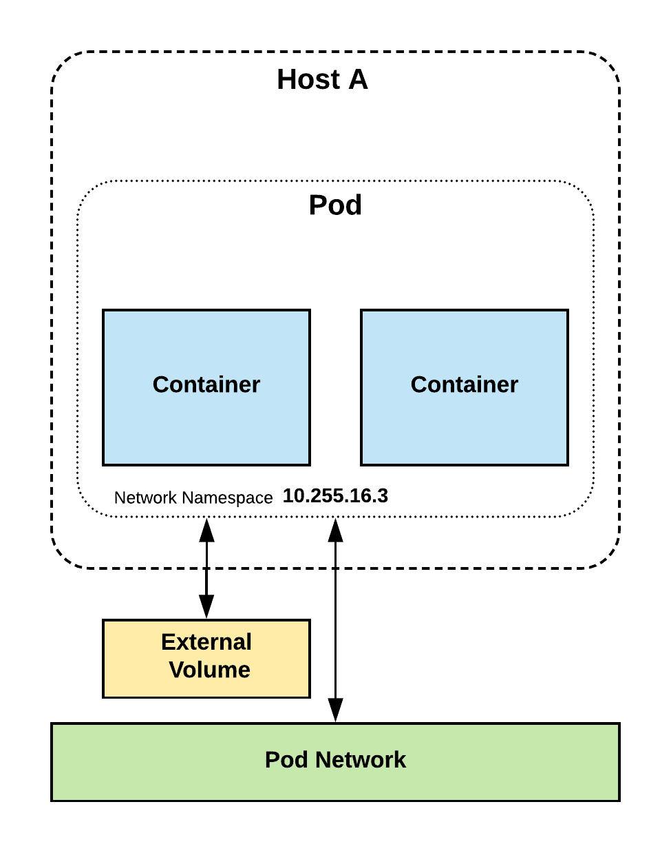
Pods
Atomic unit or smallest “unit of work”of Kubernetes.
Pods are one or MORE containers that share volumes and namespace.
They are also ephemeral!

Slide 22
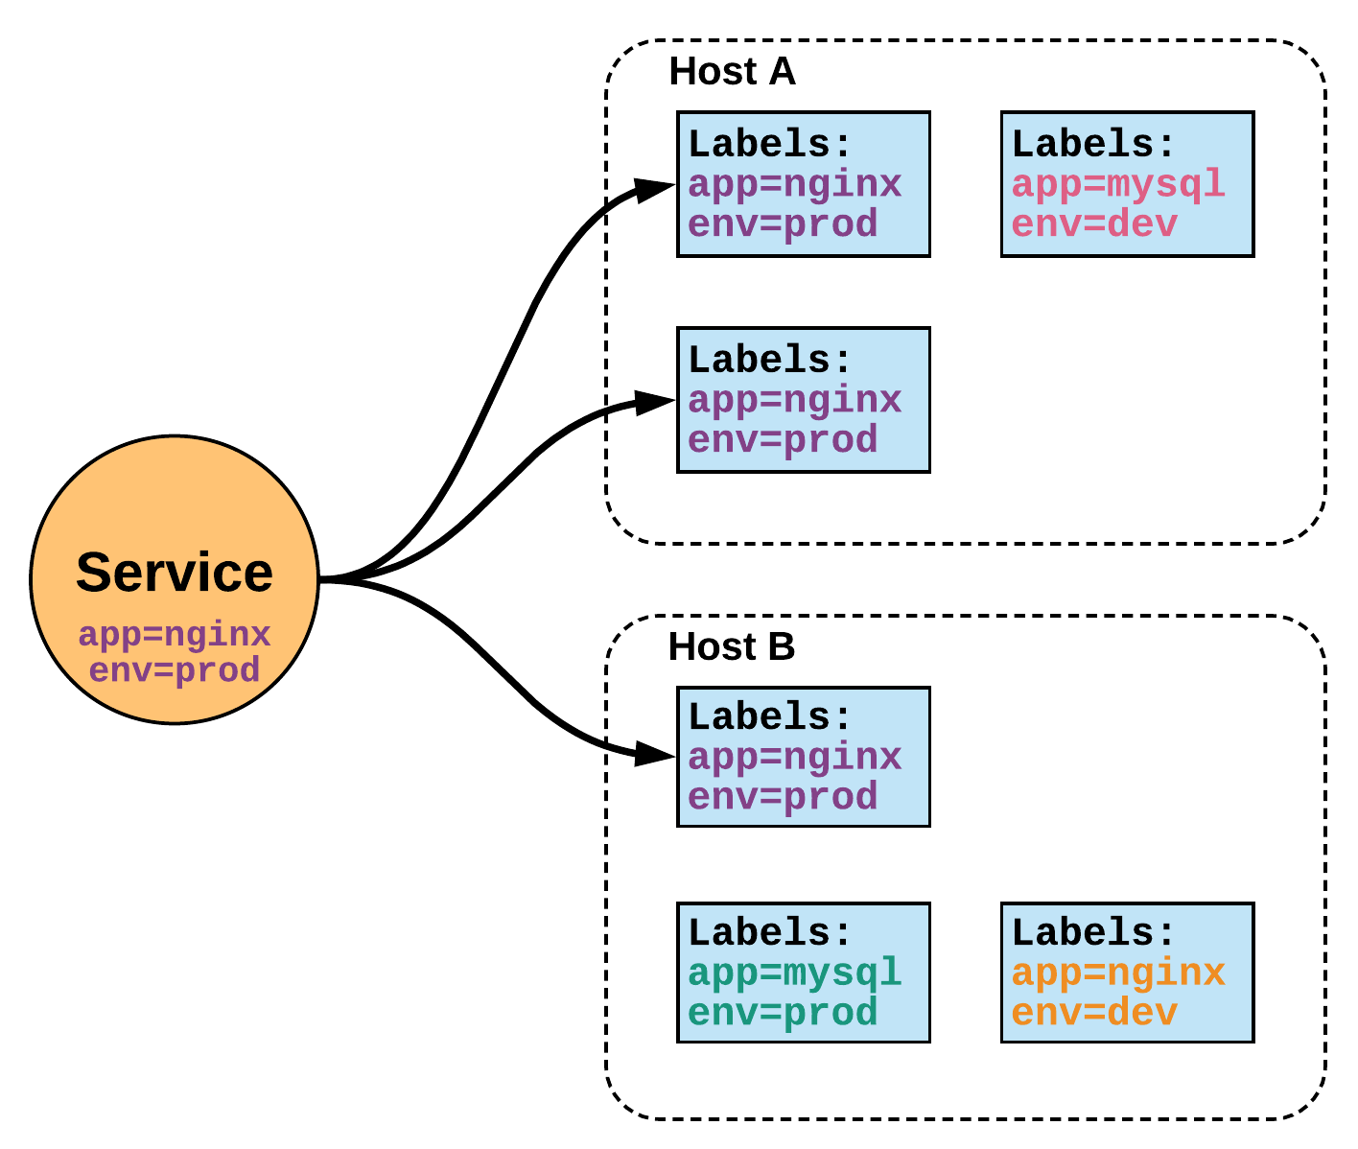
Services
Unified method of accessing the exposed workloads of Pods.
Durable resource
static cluster IP
static namespaced DNS name
Notes:
While this may seem like a technical definition, in practice it can be viewed more simply:
A service is an internal load balancer to your pod(s). You have 3 HTTP pods scheduled? Create a service, reference the pods, and (internally) it will load balance across the three.

Slide 23
Node
Components
Architecture Overview

Slide 24
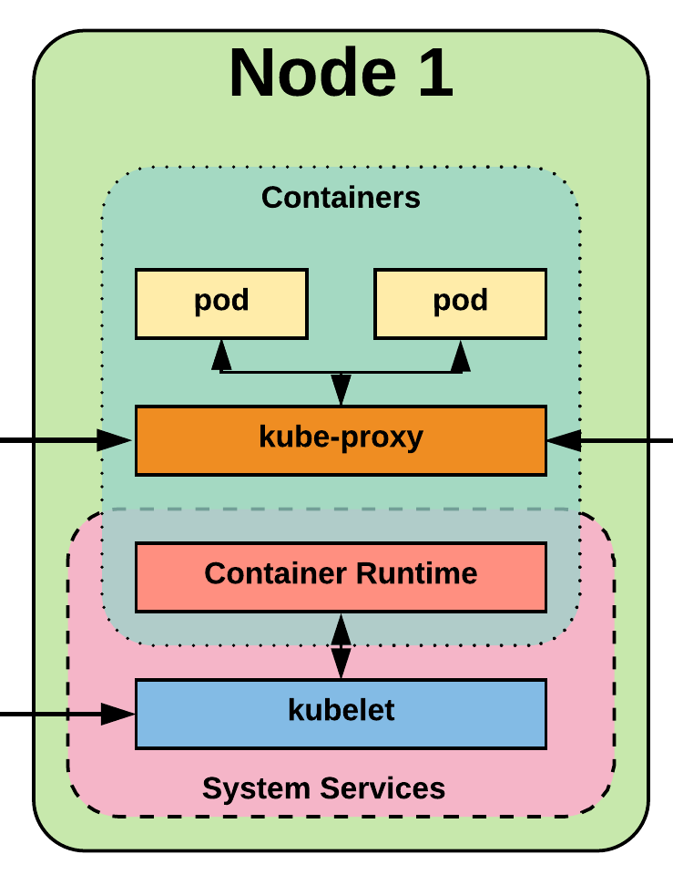
Node Components
kubelet
kube-proxy
Container Runtime Engine
Notes:
Kubelet
Agent running on every node, including the control plane
Kube-proxy
The network ‘plumber’ for Kubernetes services
Enables in-cluster load-balancing and service discovery
Container Runtime Engine
The containerizer itself - typically docker

Slide 25
kubelet
An agent that runs on each node in the cluster. It makes sure that containers are running in a pod.
The kubelet takes a set of PodSpecs that are provided through various mechanisms and ensures that the containers described in those PodSpecs are running and healthy.
Notes:
the single host daemon required for a being a part of a kubernetes cluster
can read pod manifests from several different locations
workers: poll kube-apiserver looking for what they should run
masters: run the master services as static manifests found locally on the host

Slide 26
kube-proxy
Manages the network rules on each node.
Performs connection forwarding or load balancing for Kubernetes cluster services.
Notes:
kube-proxy is the plumber
creates the rules on the host to map and expose services
uses a combination of ipvs and iptables to manage networking/loadbalancing
ipvs is more performant and opens the door to a wider feature set (port ranges, better lb rules etc)

Slide 27
Container Runtime Engine
A container runtime is a CRI (Container Runtime Interface) compatible application that executes and manages containers.
Containerd (docker)
Cri-o
Rkt
Kata (formerly clear and hyper)
Virtlet (VM CRI compatible runtime)
Notes:
Kubernetes functions with multiple different containerizers
Interacts with them through the CRI - container runtime interface
CRI creates a ‘shim’ to talk between kubelet and the container runtime
cri-o is a cool one that allows you to run any oci compatible image/runtime in Kubernetes
kata is a super lightweight KVM wrapper

Slide 28
Security

Slide 29
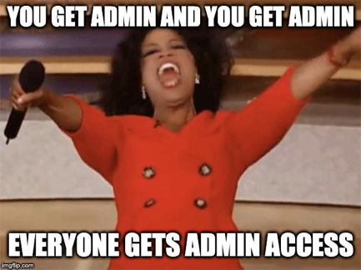

Slide 30
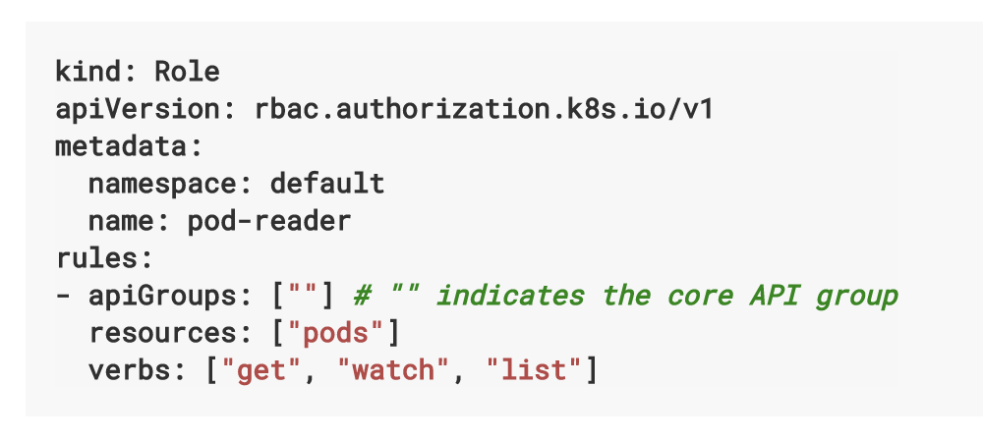
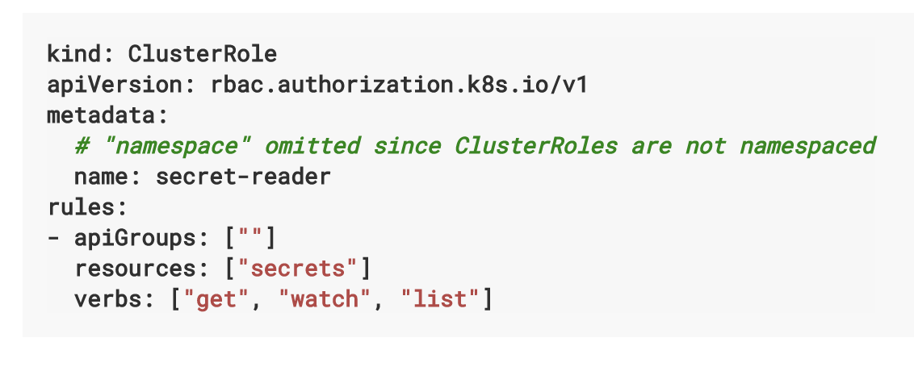
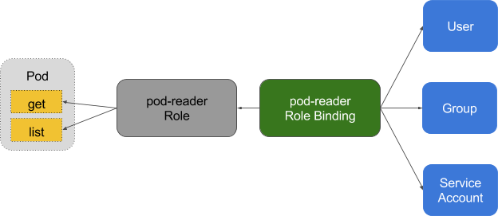
Role - Authorization
Notes:
Reminder to myself: Don’t expand on things on THIS SLIDE, use the next ones
Kubernetes adheres to these fundamental rules for networking

Slide 31
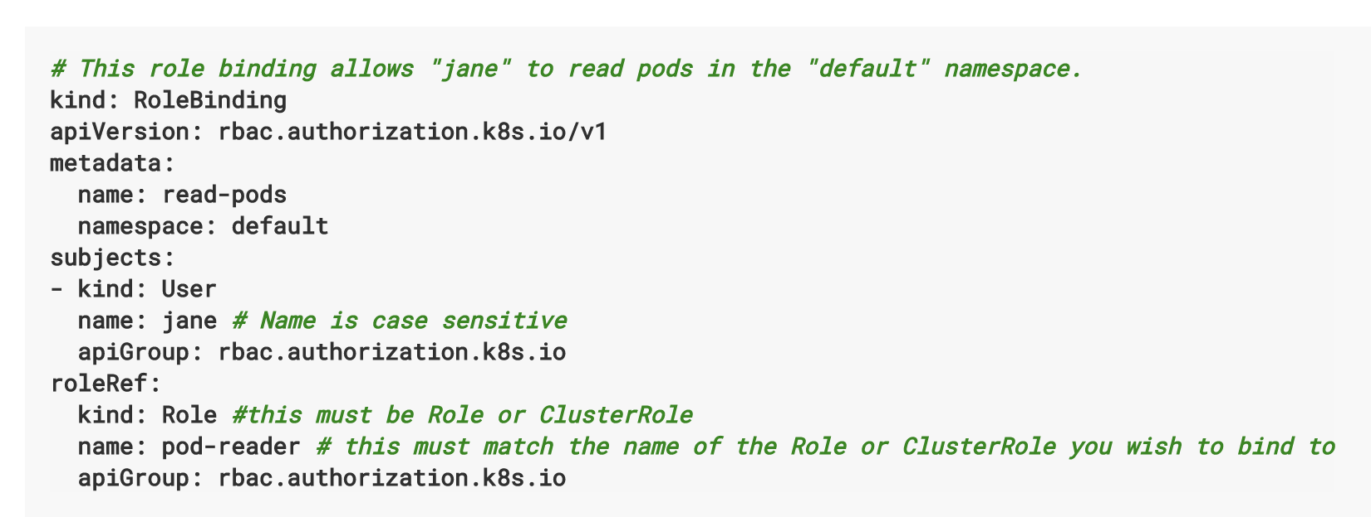
RoleBinding - Authorization
Notes:
Reminder to myself: Don’t expand on things on THIS SLIDE, use the next ones
Kubernetes adheres to these fundamental rules for networking

Slide 32
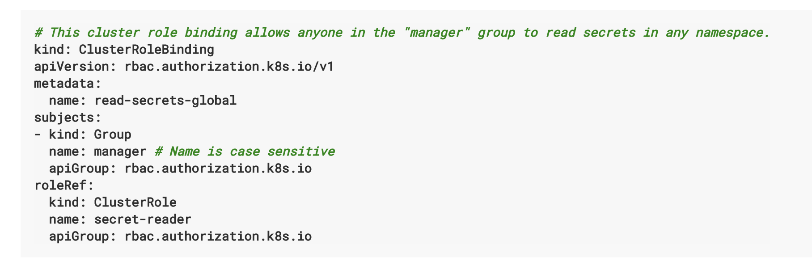
RoleBinding - Authorization
Notes:
Reminder to myself: Don’t expand on things on THIS SLIDE, use the next ones
Kubernetes adheres to these fundamental rules for networking

Slide 33
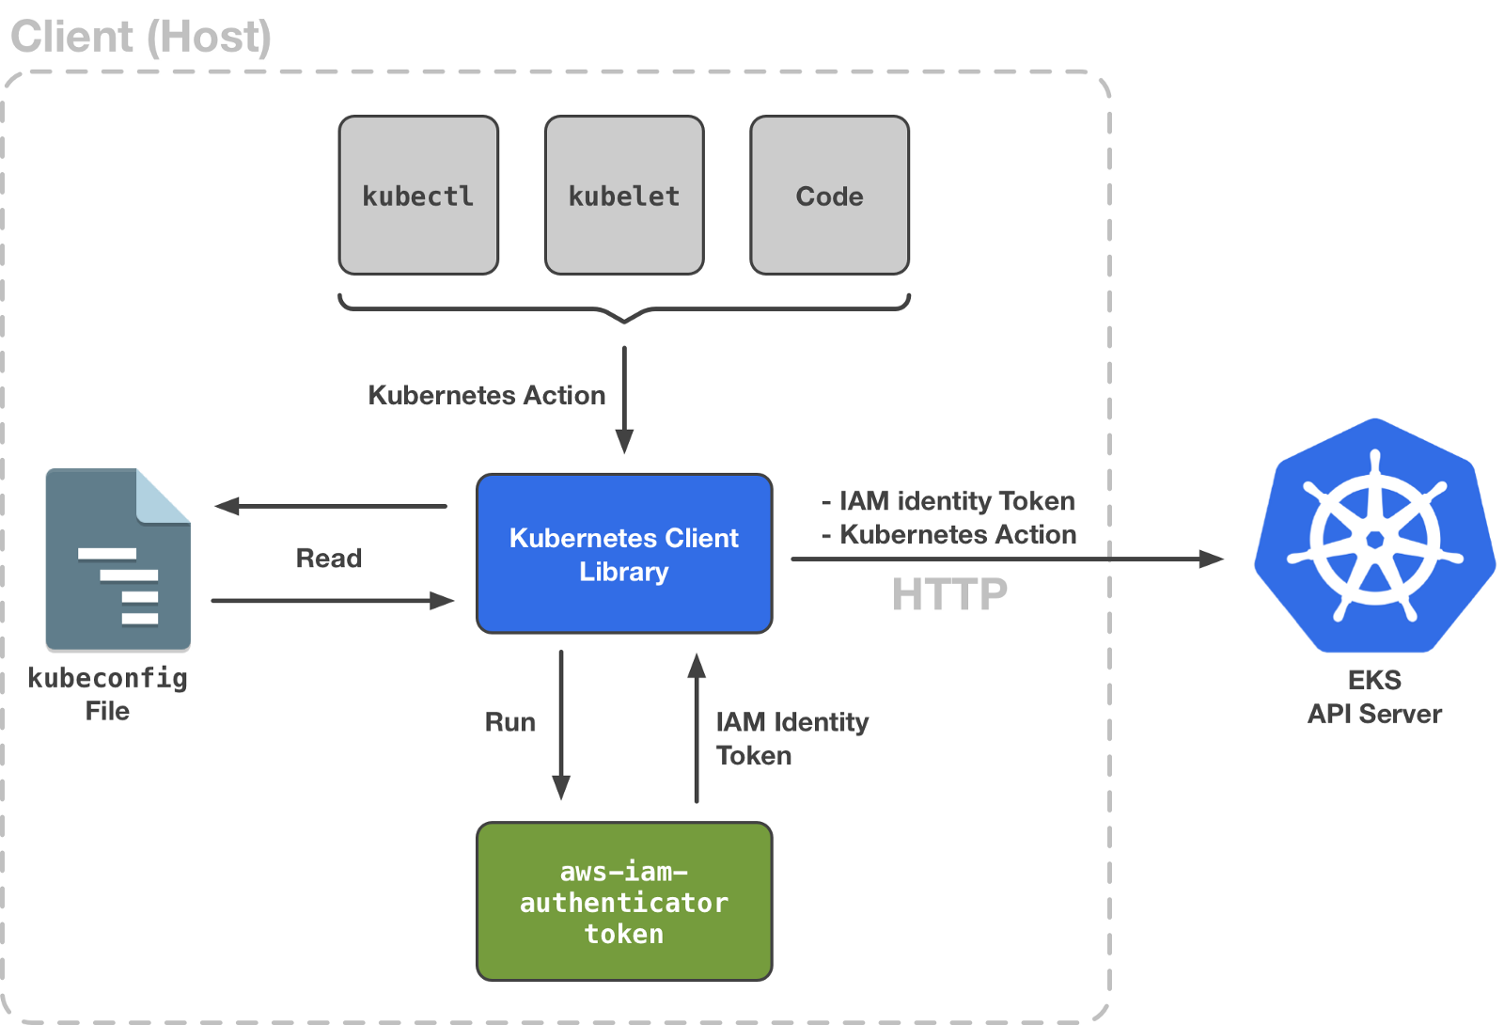
Notes:
The complete picture

Slide 34
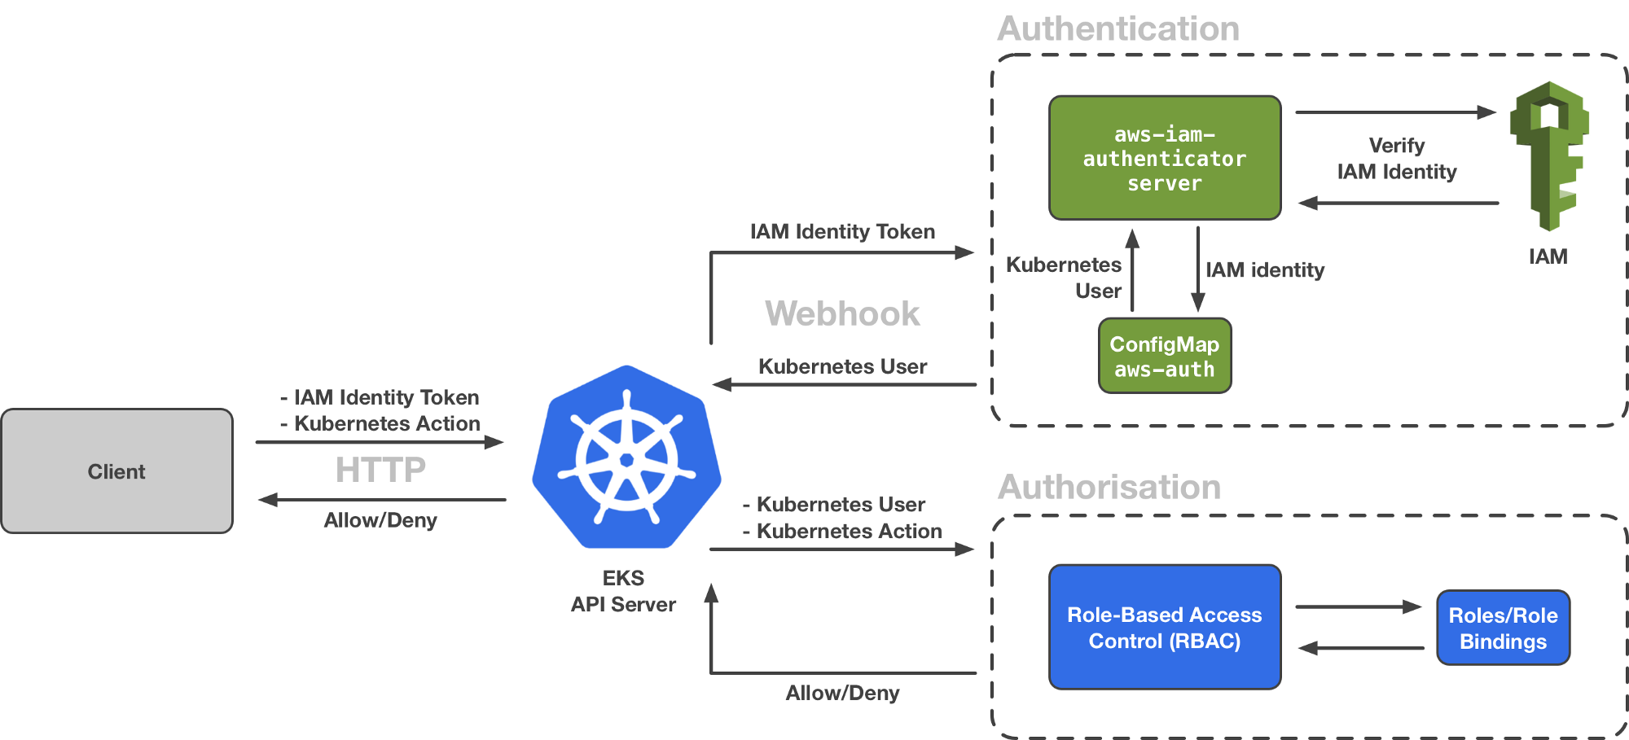
Notes:
The complete picture

Slide 35
Networking
Architecture Overview
Notes:
Networking is where people tend to get confused, they think of it like Docker
The backing cluster network is a plugin, does not work just out of the box

Slide 36
Fundamental Networking Rules
All containers within a pod can communicate with each other unimpeded.
All Pods can communicate with all other Pods without NAT.
All nodes can communicate with all Pods (and vice-versa) without NAT.
The IP that a Pod sees itself as is the same IP that others see it as.
Notes:
Reminder to myself: Don’t expand on things on THIS SLIDE, use the next ones
Kubernetes adheres to these fundamental rules for networking

Slide 37
Fundamentals Applied
Container-to-Container
Containers within a pod exist within the same network namespace and share an IP.
Enables intrapod communication over localhost.
Pod-to-Pod
Allocated cluster unique IP for the duration of its life cycle.
Pods themselves are fundamentally ephemeral.
Notes:
Pods are groups of containers into a single manageable unit
Example: app container + a container within a pod that sends logs to another service
As such the containers share a network namespace
Pods are given a cluster unique IP for the duration of its lifecycle.
Think dhcp, a Pod will be given a static lease for as long as it’s around

Slide 38
Fundamentals Applied
Pod-to-Service
managed by kube-proxy and given a persistent cluster unique IP
exists beyond a Pod’s lifecycle.
External-to-Service
Handled by kube-proxy.
Works in cooperation with a cloud provider or other external entity (load balancer).
Notes:
Both pod-to-service and external-to-service connectivity relies on kube-proxy
For pod-to-service - kubernetes creates a cluster-wide IP that can map to n-number of pods
think like a dns name, or an LB to point to containers backing your service
External Connectivity relies on an external entity, a cloud provider or some other system in conjunction with kube-proxy to map out-of-cluster access to cluster services

Slide 39
Networking (VPC CNI)
Responsible for allocating VPC IP addresses.
​The plugin consists of two primary components:
The L-IPAM daemon is responsible for attaching elastic network interfaces to instances, assigning secondary IP addresses to elastic network interfaces, and maintaining a "warm pool" of IP addresses on each node for assignment to Kubernetes pods when they are scheduled.
The CNI plugin itself is responsible for wiring the host network (for example, configuring the interfaces and virtual Ethernet pairs) and adding the correct interface to the pod namespace.
CNI:
Max. IP Addresses Per Network Interface Per Instance Type
M4.xlarge - 4 (max NI) - 15 (IPV4) - 15 (IPV6)
Max pods per instance - no. of CNI * (no. of IPv4 per CNI - 1) + 2
reference: https://github.com/awslabs/amazon-eks-ami/blob/master/files/eni-max-pods.txt

Slide 40
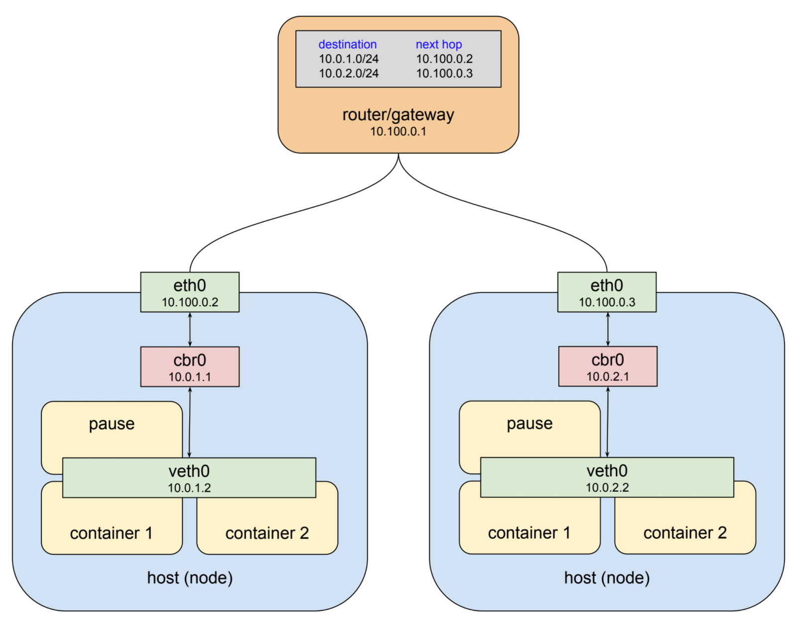
Networking in a Node

Slide 41
Namespaces
Pods
Labels
Selectors
Services
Core
Objects and API
Concepts and Resources
Notes:
Ns,pod: Jeff
Labels,Selectors: Bob
Service intro: Jeff

Slide 42
Namespaces
Namespaces are a logical cluster or environment, and are the primary method of partitioning a cluster or scoping access.
apiVersion: v1
kind: Namespace
metadata:
name: myNamespace
labels:
app: myApp
$ kubectl get ns --show-labels
NAME STATUS AGE LABELS
default Active 11h <none>
kube-public Active 11h <none>
kube-system Active 11h <none>
myNamespace Active 6s app=myApp
Notes:
Think like a scope or even a subdomain
This is a very similar concept to namespaces in programming. In fact it is the same, just for application architecture.

Slide 43
Pod Examples
Notes:
Discuss sidecar pattern
This is a good example of a pod having multiple containers

Slide 44
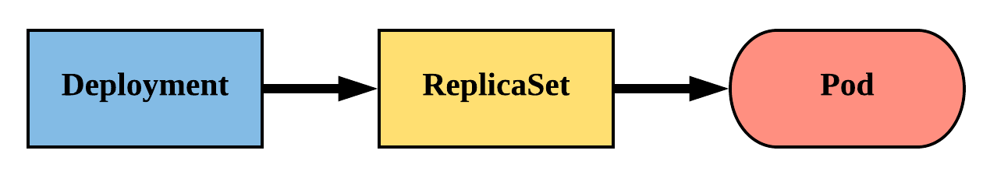
Deployment
Way of managing Pods via ReplicaSets.
Provide rollback functionality and update control.
Updates are managed through the pod-template-hash label.
Each iteration creates a unique label that is assigned to both the ReplicaSet and subsequent Pods.
Notes:
The real way we manage pods
Deployments manage replicasets which then manage pods
Rare that you manage replicasets directly because they are ‘dumb’
Offer update control and rollback functionality, gives blue/green deployment
Does this through hashing the pod template and storing that value in a label, the pod template hash
Used in replicaset name
Added to the selector and pod labels automatically
gives us a unique selector that strictly targets a revision of a pod

Slide 45
Deployment
revisionHistoryLimit: The number of previous iterations of the Deployment to retain.
strategy: Describes the method of updating the Pods based on the type. Valid options are Recreate or RollingUpdate.
Recreate: All existing Pods are killed before the new ones are created.
RollingUpdate: Cycles through updating the Pods according to the parameters: maxSurge and maxUnavailable.
apiVersion: apps/v1
kind: Deployment
metadata:
name: deploy-example
spec:
replicas: 3 revisionHistoryLimit: 3
selector:
matchLabels:
app: nginx env: prod
strategy:
type: RollingUpdate
rollingUpdate:
maxSurge: 1
maxUnavailable: 0
template:
<pod template>
Notes:
Since we now have rollback functionality, we now have to know how many previous versions we want to keep
strategy describes the method used to update the deployment
recreate is pretty self explanatory, nuke it and recreate, not graceful
rolling update is what we normally want
max Sure == how many ADDITIONAL replicas we want to spin up while updating
max Unavailable == how many may be unavailable during the update process
Lets say you’re resource constrained and can only support 3 replicas of the pod at any one time We could set maxSurge to 0 and maxUnavailable to 1. This would cycle through updating 1 at a time without spinning up additional pods.

Slide 46
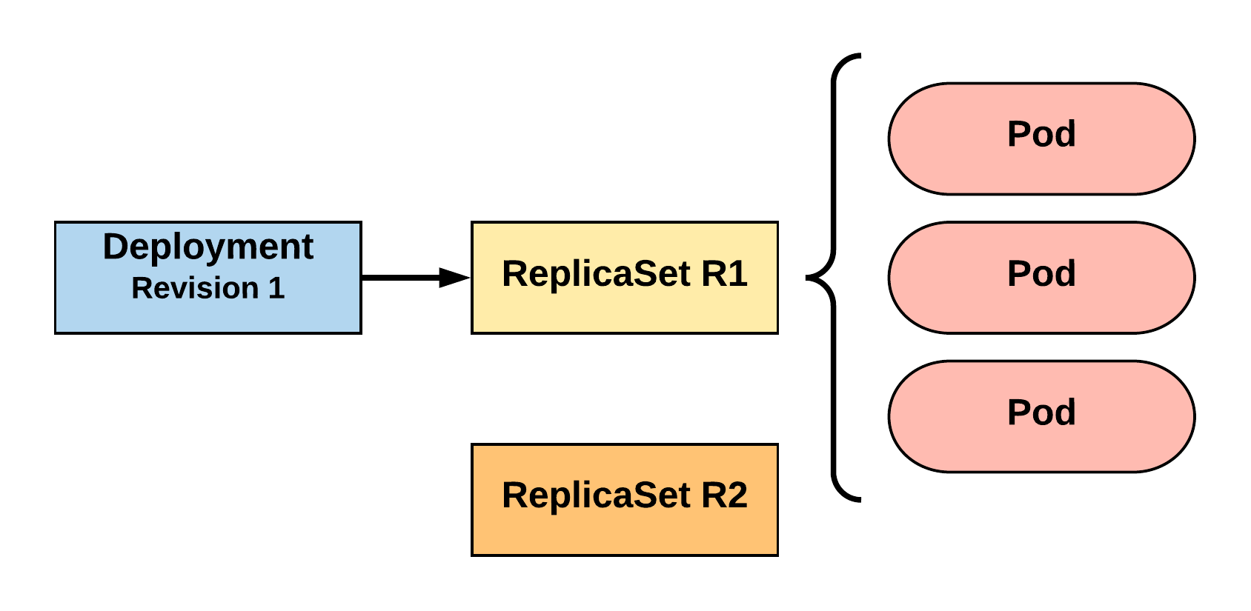
RollingUpdate Deployment
Updating pod template generates a new ReplicaSet revision.
R1 pod-template-hash: 676677fff
R2 pod-template-hash: 54f7ff7d6d
$ kubectl get replicaset
NAME DESIRED CURRENT READY AGE
mydep-6766777fff 3 3 3 5h
$ kubectl get pods
NAME READY STATUS RESTARTS AGE
mydep-6766777fff-9r2zn 1/1 Running 0 5h
mydep-6766777fff-hsfz9 1/1 Running 0 5h
mydep-6766777fff-sjxhf 1/1 Running 0 5h
Notes:
We add a new label, change the image, do something to change the pod template in some way
The deployment controller creates a new replicaset with 0 instances to start

Slide 47
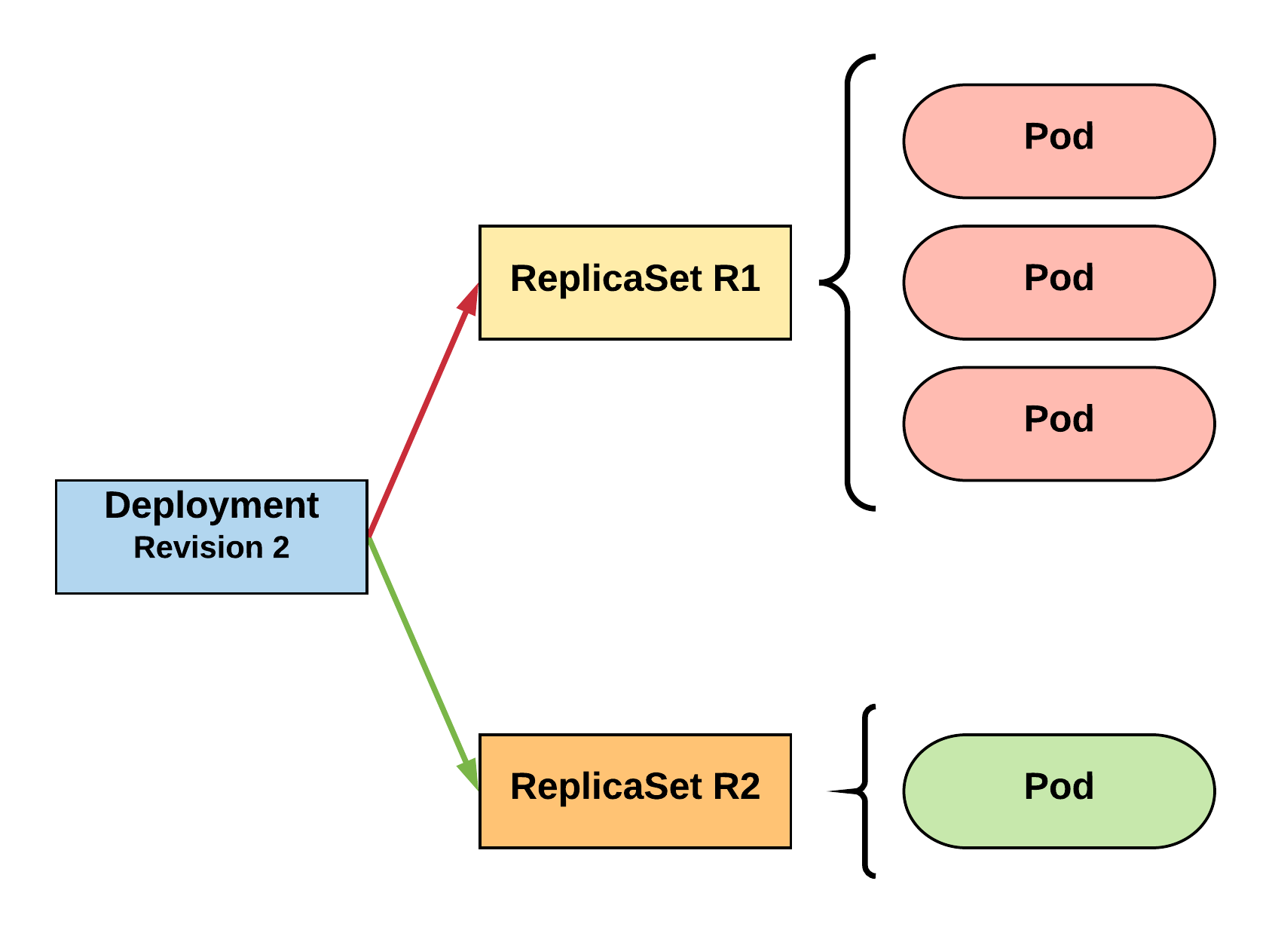
RollingUpdate Deployment
New ReplicaSet is initially scaled up based on maxSurge.
R1 pod-template-hash: 676677fff
R2 pod-template-hash: 54f7ff7d6d
$ kubectl get replicaset
NAME DESIRED CURRENT READY AGE mydep-54f7ff7d6d 1 1 1 5s
mydep-6766777fff 2 3 3 5h
$ kubectl get pods
NAME READY STATUS RESTARTS AGE
mydep-54f7ff7d6d-9gvll 1/1 Running 0 2s
mydep-6766777fff-9r2zn 1/1 Running 0 5h
mydep-6766777fff-hsfz9 1/1 Running 0 5h
mydep-6766777fff-sjxhf 1/1 Running 0 5h
Notes:
It then scales up the new ReplicaSet based on our maxSurge value

Slide 48
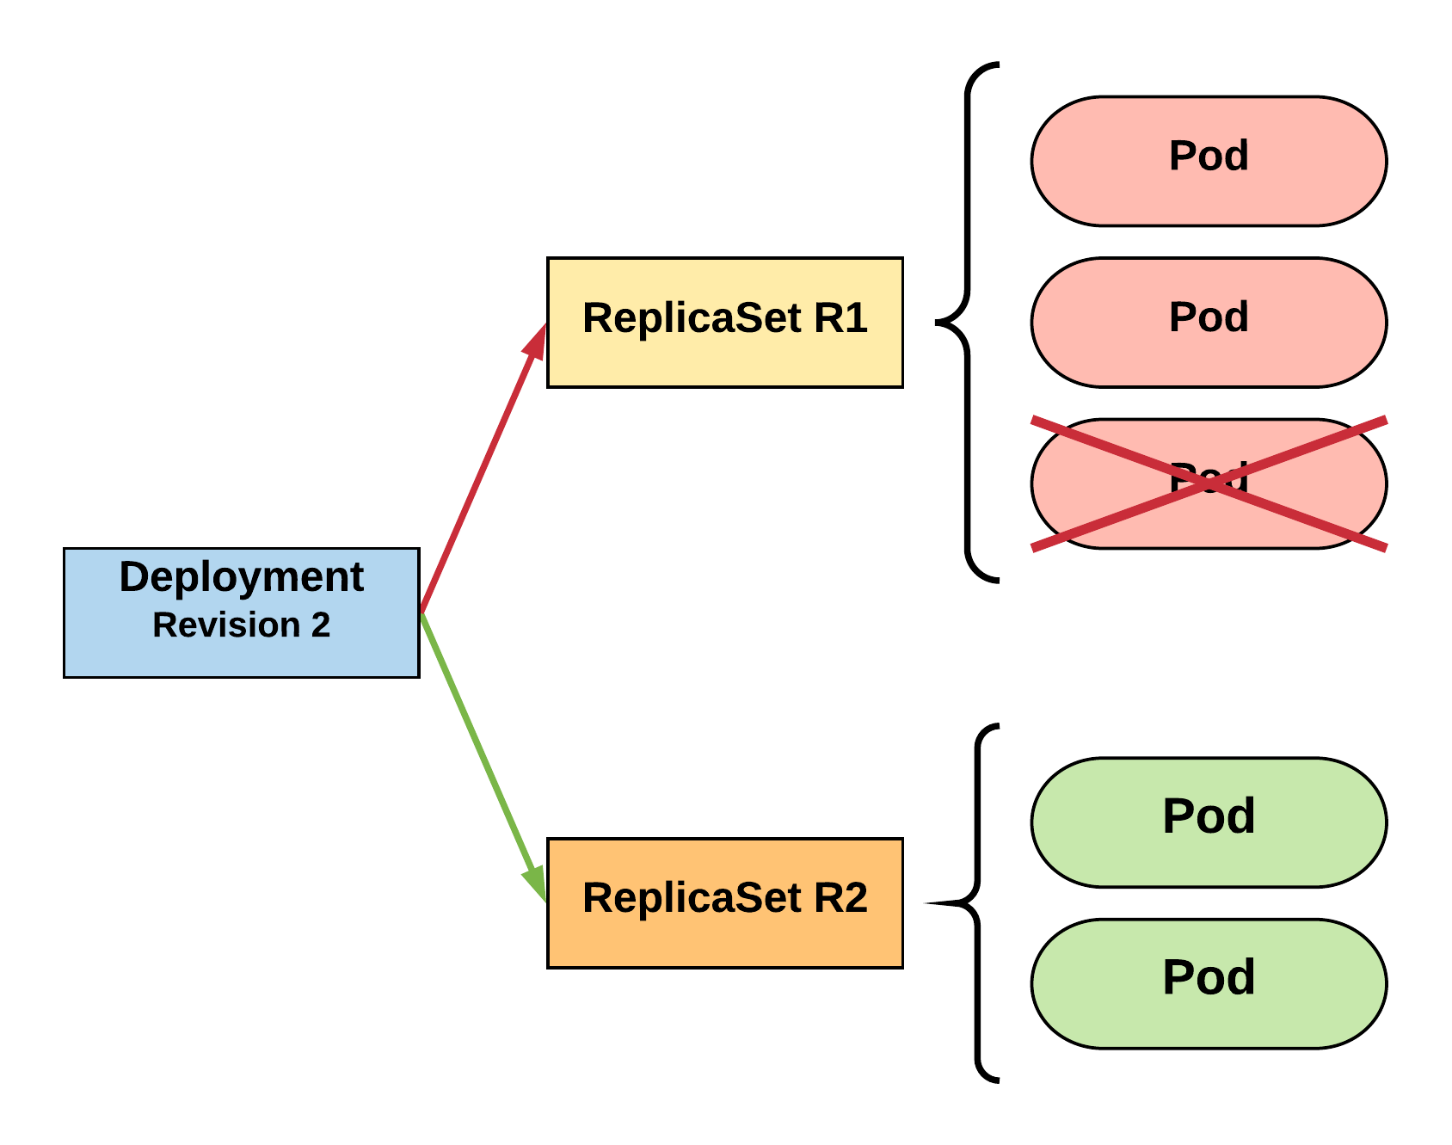
RollingUpdate Deployment
Phase out of old Pods managed by maxSurge and maxUnavailable.
R1 pod-template-hash: 676677fff
R2 pod-template-hash: 54f7ff7d6d
$ kubectl get replicaset
NAME DESIRED CURRENT READY AGE mydep-54f7ff7d6d 2 2 2 8s
mydep-6766777fff 2 2 2 5h
$ kubectl get pods
NAME READY STATUS RESTARTS AGE
mydep-54f7ff7d6d-9gvll 1/1 Running 0 5s
mydep-54f7ff7d6d-cqvlq 1/1 Running 0 2s
mydep-6766777fff-9r2zn 1/1 Running 0 5h
mydep-6766777fff-hsfz9 1/1 Running 0 5h
Notes:
It will then begin to kill off the prevision revision by scaling down the old replicaset and scaling up the new one

Slide 49
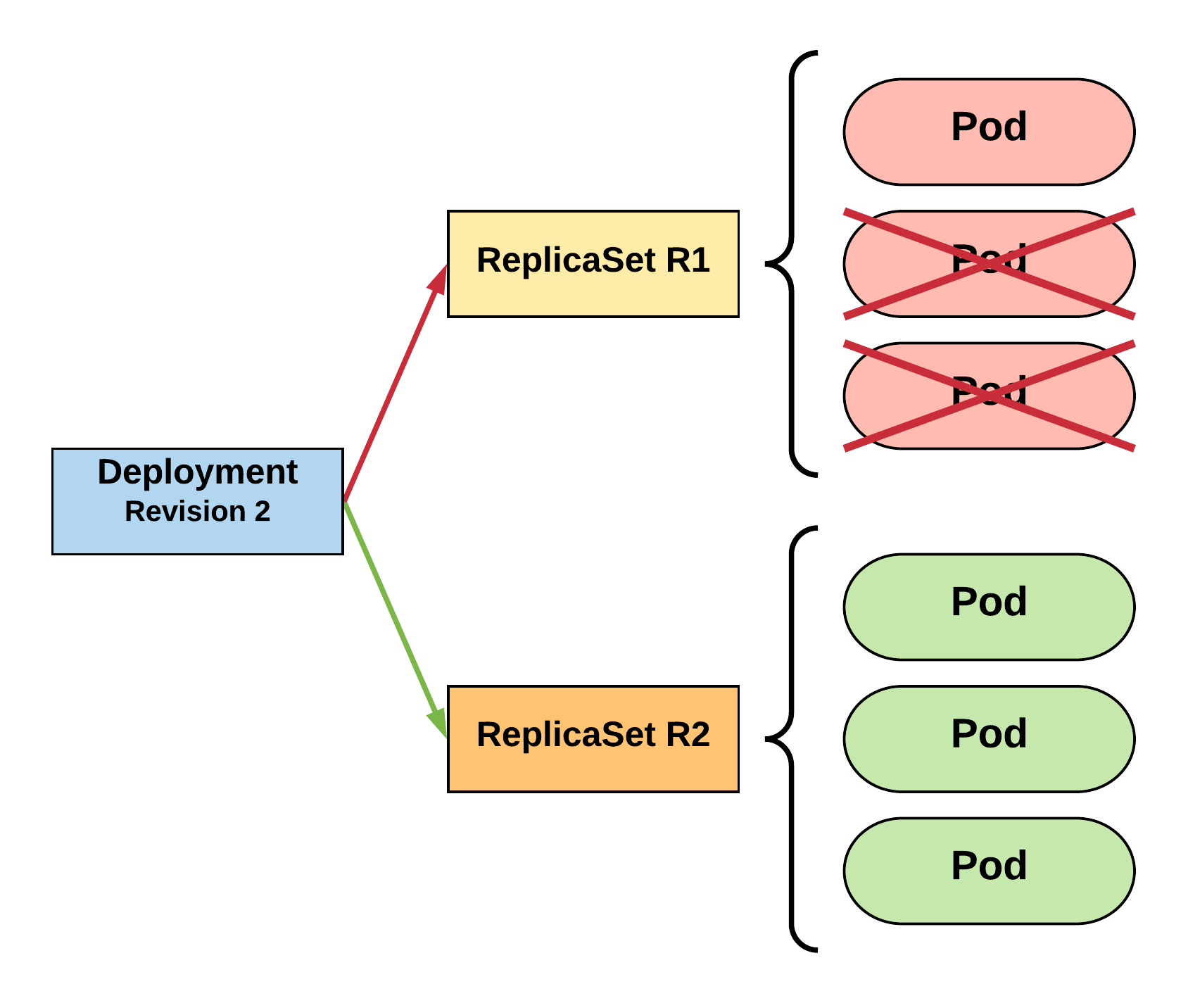
RollingUpdate Deployment
Phase out of old Pods managed by maxSurge and maxUnavailable.
R1 pod-template-hash: 676677fff
R2 pod-template-hash: 54f7ff7d6d
$ kubectl get replicaset
NAME DESIRED CURRENT READY AGE mydep-54f7ff7d6d 3 3 3 10s
mydep-6766777fff 0 1 1 5h
$ kubectl get pods
NAME READY STATUS RESTARTS AGE
mydep-54f7ff7d6d-9gvll 1/1 Running 0 7s
mydep-54f7ff7d6d-cqvlq 1/1 Running 0 5s
mydep-54f7ff7d6d-gccr6 1/1 Running 0 2s
mydep-6766777fff-9r2zn 1/1 Running 0 5h
Notes:
Continues this pattern based on maxSurge and maxUnavailable

Slide 50
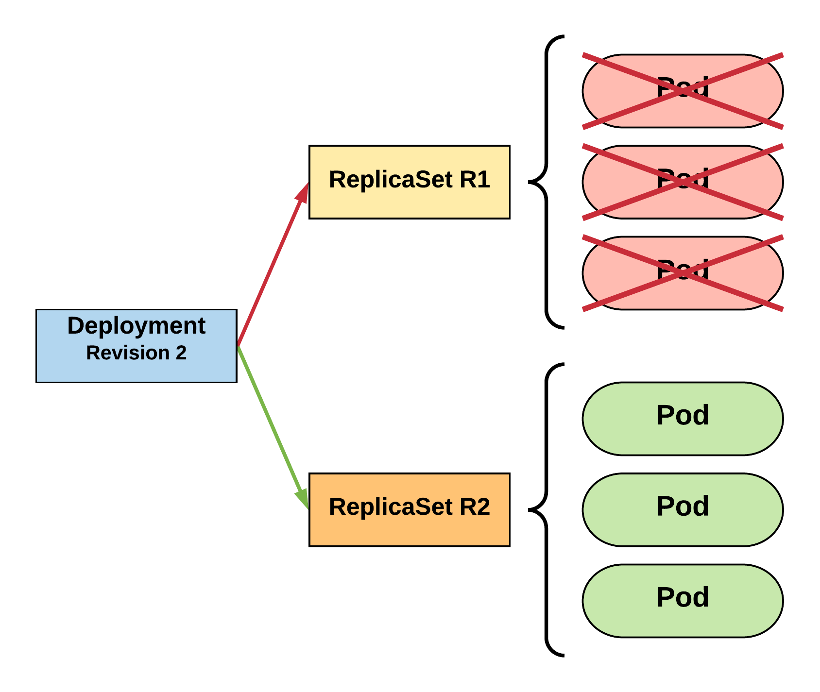
RollingUpdate Deployment
Phase out of old Pods managed by maxSurge and maxUnavailable.
R1 pod-template-hash: 676677fff
R2 pod-template-hash: 54f7ff7d6d
$ kubectl get replicaset
NAME DESIRED CURRENT READY AGE
mydep-54f7ff7d6d 3 3 3 13s mydep-6766777fff 0 0 0 5h
$ kubectl get pods
NAME READY STATUS RESTARTS AGE
mydep-54f7ff7d6d-9gvll 1/1 Running 0 10s
mydep-54f7ff7d6d-cqvlq 1/1 Running 0 8s
mydep-54f7ff7d6d-gccr6 1/1 Running 0 5s
Notes:
Update is complete

Slide 51
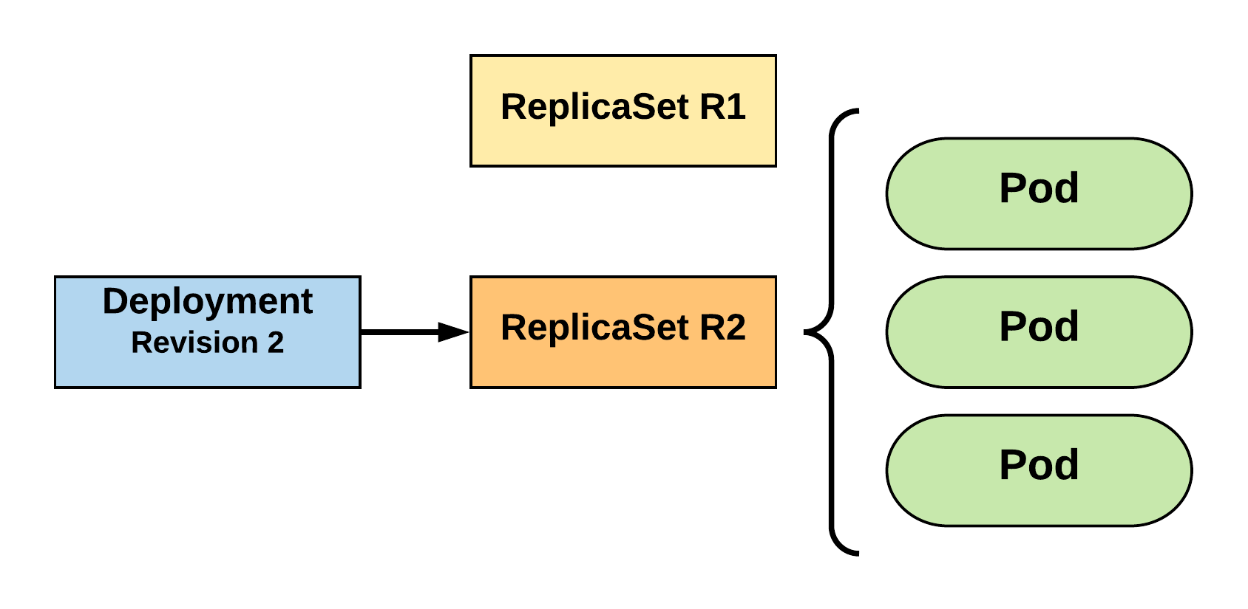
RollingUpdate Deployment
Updated to new deployment revision completed.
R1 pod-template-hash: 676677fff
R2 pod-template-hash: 54f7ff7d6d
$ kubectl get replicaset
NAME DESIRED CURRENT READY AGE mydep-54f7ff7d6d 3 3 3 15s
mydep-6766777fff 0 0 0 5h
$ kubectl get pods
NAME READY STATUS RESTARTS AGE
mydep-54f7ff7d6d-9gvll 1/1 Running 0 12s
mydep-54f7ff7d6d-cqvlq 1/1 Running 0 10s
mydep-54f7ff7d6d-gccr6 1/1 Running 0 7s
Notes:
Until the previous revision is at 0
ReplicaSet will remain around, but it will have 0 replicas. How many stay around are based off our revision history limit

Slide 52
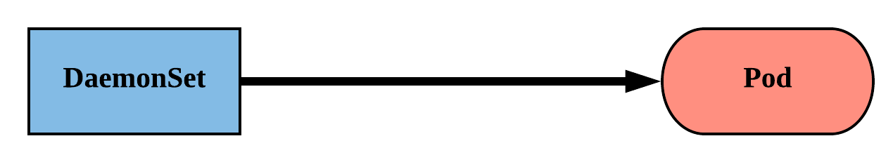
DaemonSet
Ensure that all nodes matching certain criteria will run an instance of the supplied Pod.
Are ideal for cluster wide services such as log forwarding or monitoring.
Notes:
Daemonsets schedule pods across all nodes matching certain criteria.
They work best for services like log shipping and health monitoring.
The criteria can be anything from the specific OS or Arch, or your own cluster-specific labels.

Slide 53
Replication Controller
A ReplicationController ensures that a specified number of pod replicas are running at any one time.
In other words, a ReplicationController makes sure that a pod or a homogeneous set of pods are always up and available.
*Deprecated*

Slide 54
Health checks
apiVersion: v1
kind: Pod
metadata:
labels:
test: liveness
name: liveness-readiness-http
spec:
containers:
- name: liveness-readiness-http
image: k8s.gcr.io/ liveness-readiness-http
livenessProbe:
httpGet:
path: /healthz
port: 8080
initialDelaySeconds: 5
periodSeconds: 10
timeoutSeconds: 4
failureThreshold: 5
readinessProbe:
httpGet:
path: /healthz
port: 8080
initialDelaySeconds: 100
periodSeconds: 10
timeoutSeconds: 4
failureThreshold: 2
initialDelaySeconds: Number of seconds after the container has started before liveness or readiness probes are initiated.
periodSeconds: How often (in seconds) to perform the probe. Default to 10 seconds. Minimum value is 1.
timeoutSeconds: Number of seconds after which the probe times out. Defaults to 1 second. Minimum value is 1.
successThreshold: Minimum consecutive successes for the probe to be considered successful after having failed. Defaults to 1. Must be 1 for liveness. Minimum value is 1.
failureThreshold: When a Pod starts and the probe fails, Kubernetes will try failureThreshold times before giving up. Giving up in case of liveness probe means restarting the Pod. In case of readiness probe the Pod will be marked Unready. Defaults to 3. Minimum value is 1.
Notes:
Note successfulJobsHistoryLImit and failedJobsHistoryLimit
Oh hey a jobTemplate.

Slide 55
Workflow

Slide 56
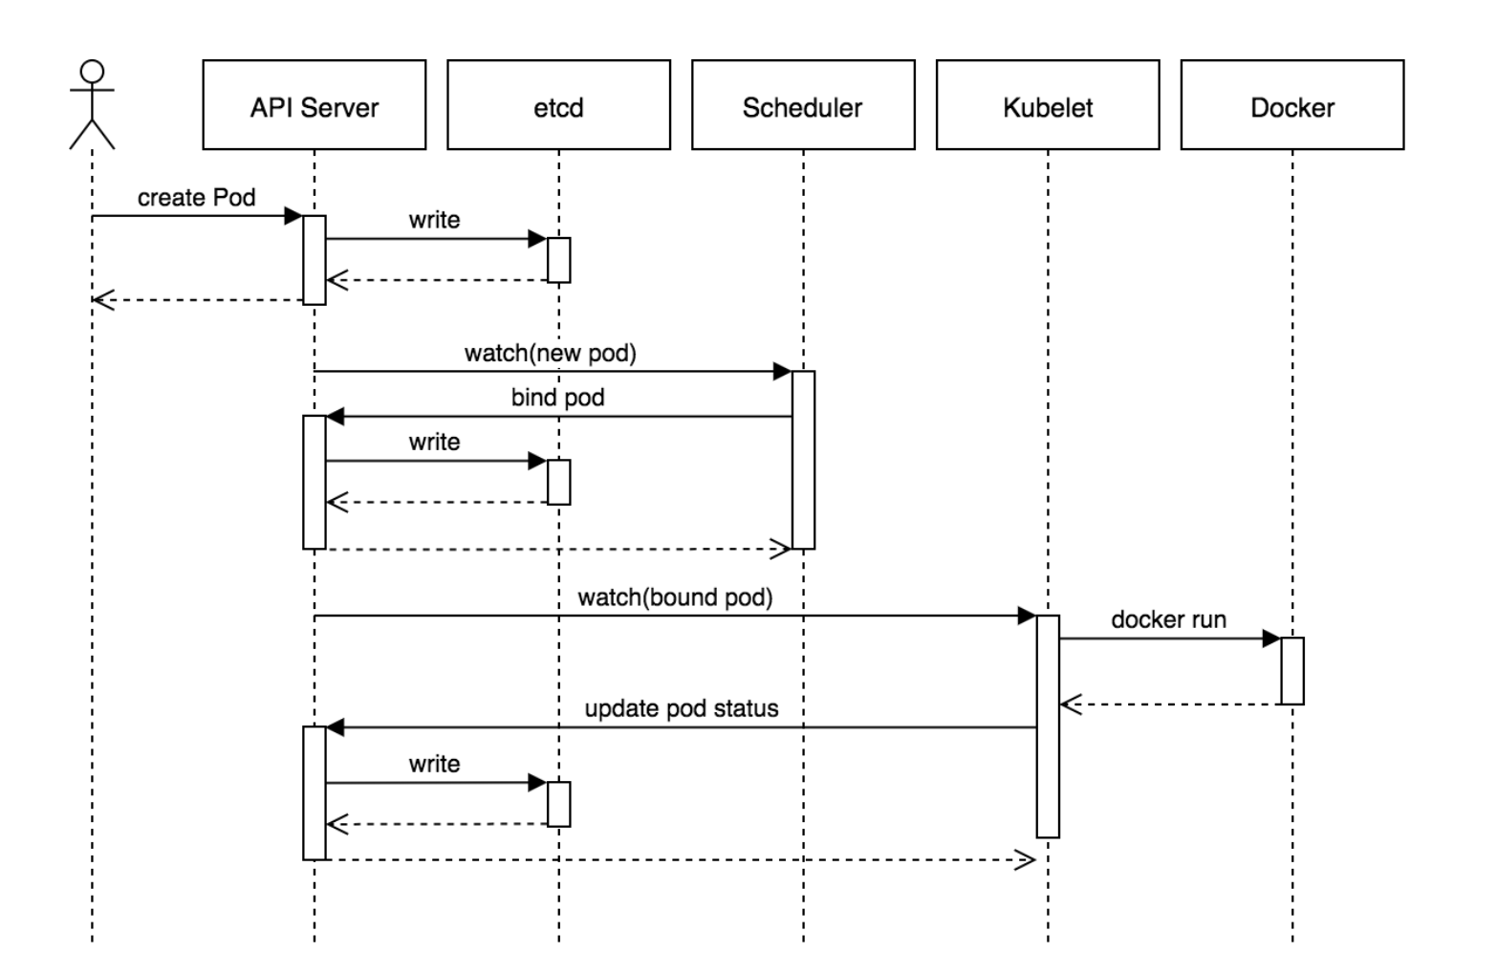
Notes:
It then scales up the new ReplicaSet based on our maxSurge value

Slide 57
Istio

Slide 58
Service Mesh
A service mesh is a configurable, low‑latency infrastructure layer designed to handle a high volume of network‑based interprocess communication among application infrastructure services using application programming interfaces (APIs)
A service mesh ensures that communication among containerized and often ephemeral application infrastructure services is fast, reliable, and secure.
The mesh provides critical capabilities including service discovery, load balancing, encryption, observability, traceability, authentication and authorization, and support for the circuit breaker pattern.

Slide 59
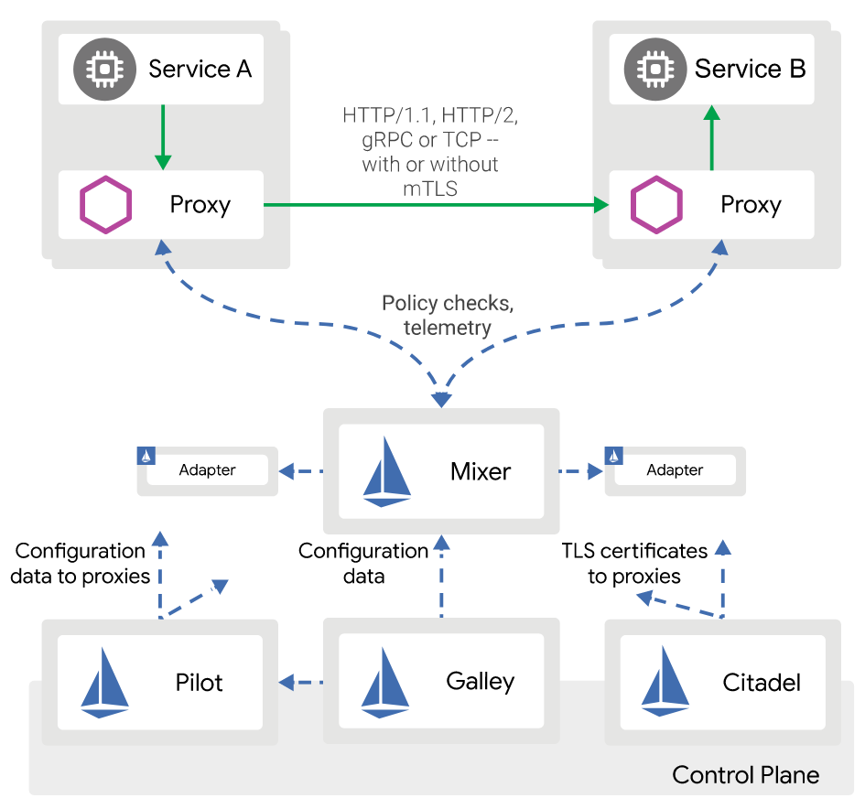
Istio in Kubernetes
Automatic load balancing for HTTP, gRPC, WebSocket, and TCP traffic.
Fine-grained control of traffic behavior with rich routing rules, retries, failovers, and fault injection.
A pluggable policy layer and configuration API supporting access controls, rate limits and quotas.
Automatic metrics, logs, and traces for all traffic within a cluster, including cluster ingress and egress - Observability
Secure service-to-service communication in a cluster with strong identity-based authentication and authorization.

Slide 60
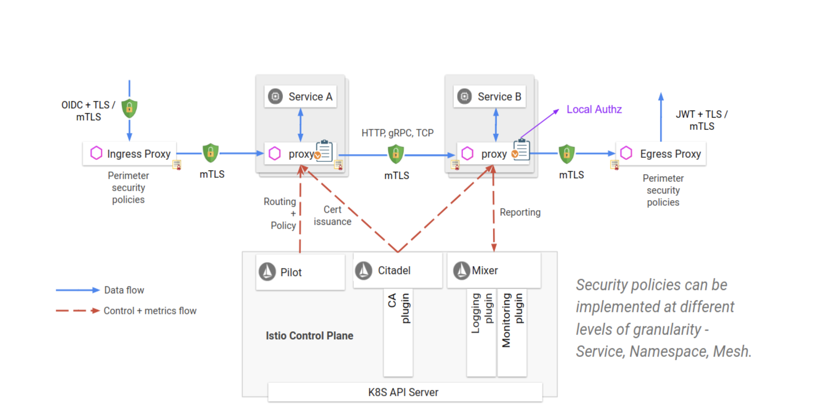
Istio / Security
Citadel for key and certificate management
Sidecar and perimeter proxies to implement secure communication and authorization between clients and servers
Pilot to distribute authentication policies and secure naming information to the proxies
Mixer to manage auditing

Slide 61
Visualizing with Kiali UI

Slide 62
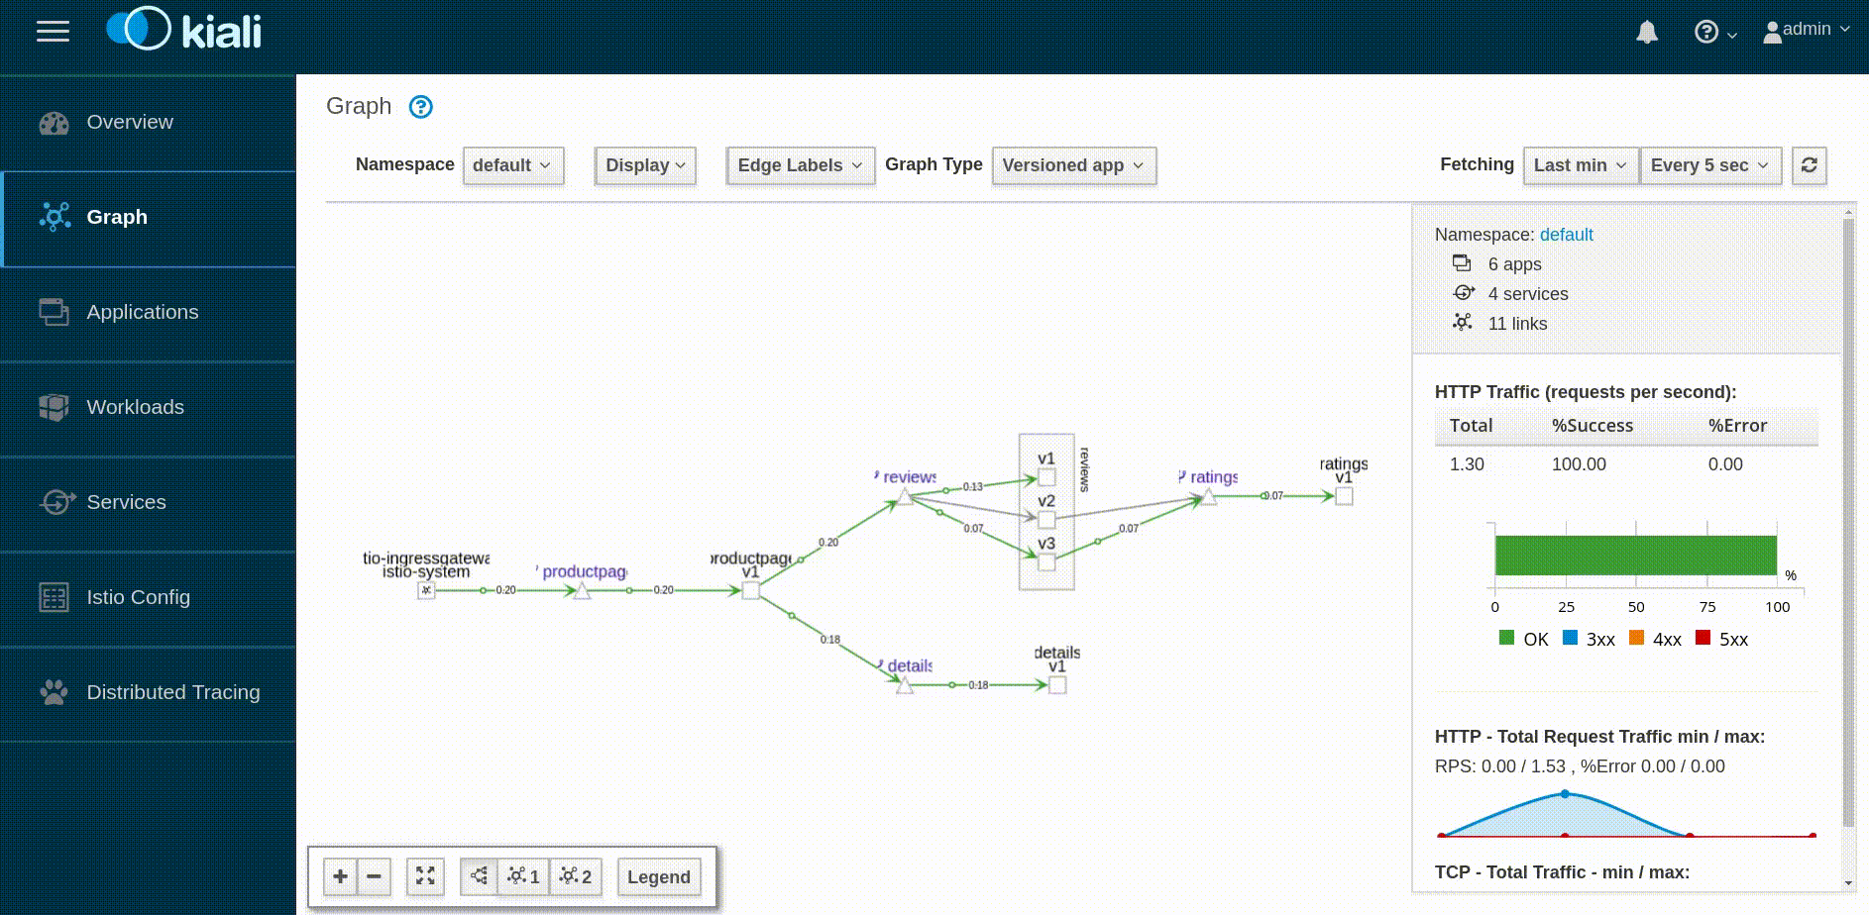
Visualizing with Kiali UI

Slide 63
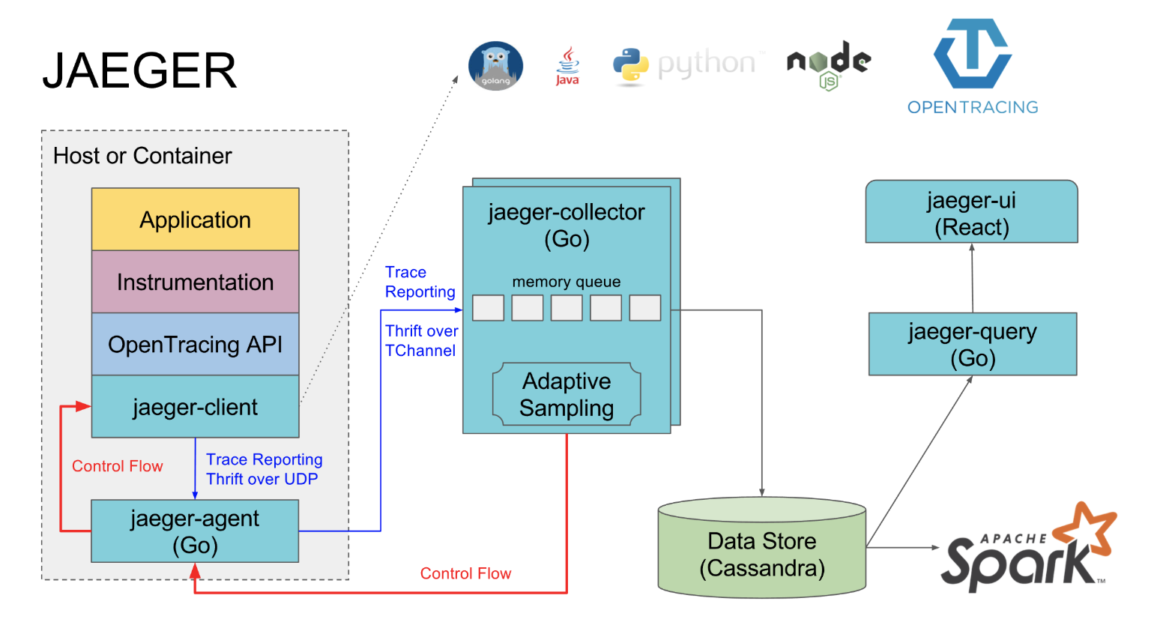
Distributed Tracing with Jaeger

Slide 64
Best Practices - App Dev
Health Checks:
Containers have Readiness probes/ Liveness Probes
Run more than one replica for your Deployment
Avoid Pods being placed into a single node
Set Resource Limits - CPU/Mem
Resources have labels enabled - Technical/Business/Security
The application logs to stdout and stderr (Passive Logging)
Containers do not store any state in their local filesystem
Use the Horizontal Pod Autoscaler for apps with variable usage patterns
Use the Cluster Autoscaler if you have highly varying workloads
Externalise all configuration
Mount Secrets as volumes, not enviroment variables

Slide 65
Best Practices - Governance
Namespaces have ResourceQuotas
Enable Pod Security Policies
Enable network policies
Prevent containers from running as root
RBAC policies are set to the least amount of privileges necessary
Allow deploying containers only from known registries
Logging:
There's a retention and archival strategy for logs
Logs are collected from Nodes, Control Plane, Auditing
Prefer a daemon on each node to collect the logs instead of sidecars (Applications should log to stdout rather than to files.)

Slide 66
Questions

